Slide 1
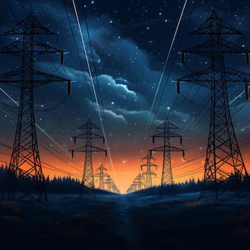
Network Video
& Image Displayer using docker containers
ERIK LANEAVE – 5313
GILBERT GUZMAN – 4316
FERNANDO H. REMES – 4316
JACOB GONZALEZ – 4316
DR. DEEPAK TOSH – COMPUTER NETWORKS [CS 4316 & CS 5313]
[CRN: 21955]

Slide 2
Table of Contents
01
02
04
05
06
03
Why Did
We Choose This Project?
What is Docker?
Setup /
Project Timeline
-Initial Project Ideas
-Considerations on Methodology
-Chosen over VMs?
-Docker Benefits Breakdown
-Goals and Initial Ideas
-Development Timeline Breakdown
UI Design /
Development Difficulties
Results /
Project Screenshots
Conclusion
-Design Decisions for User GUI
-Problems & Solutions
-NVID-DC Screenshots
-NVID-DC Walkthrough
-What did we learn?
-How can we add to this project?
Notes:
(Folow the report) intro, problem statement, approach, results, conclusion.

Slide 3

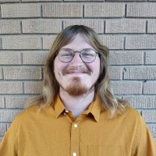
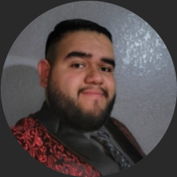
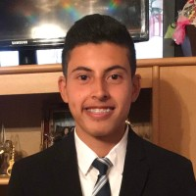
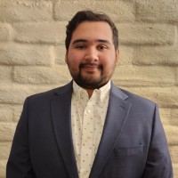
Meet The Team
Erik laneave
Team lead
Back-End lead
Gilbert guzman
Presentation lead
RESEARCH + Code SUPPORT
Fernando remes
Front end lead
Research + code support
Jacob gonzalez
Research support

Slide 4
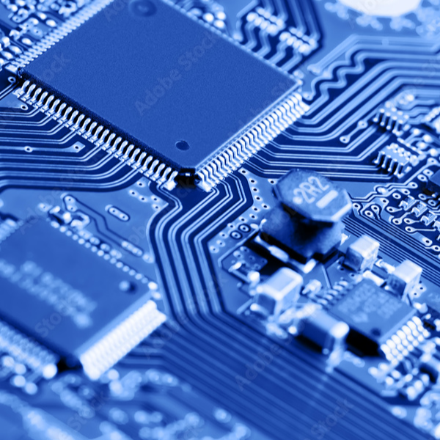
01
Why Did We Choose This Project?
"There's a ton of problems, why choose this one?"

Slide 5
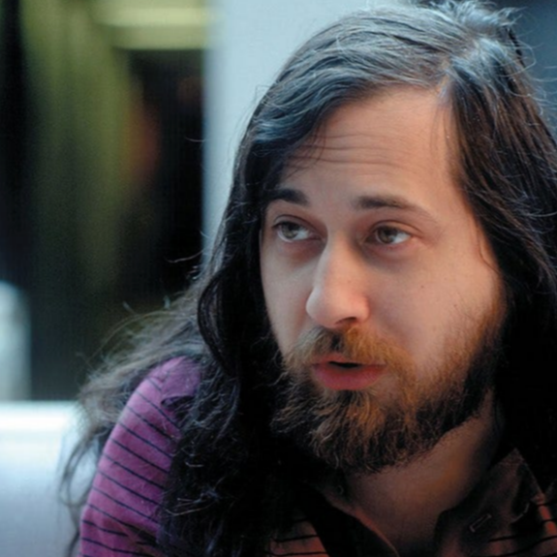
-Richard Stallman [Founder of GNU and The Free Software Foundation]
We Use Tech To Share:
“Sharing is good, and with digital technology, sharing is easy.”

Slide 6
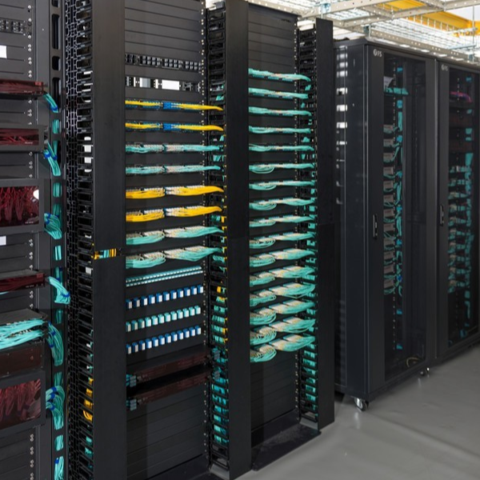
Why Did We Choose This Project?
Originally, we had two ideas for this project:
1. Controlling Smart Home Tech via TCP connection to an AI.
2. Sending Encrypted Photos and Videos over network using Dockers.
We went for the second option, for two reasons:
Our Team Leader had a research interest in Docker.
We liked the dynamic use cases of our idea if it was properly implemented.
Sending Images to family/friends, acting as a present when they opened their device.
Quick distribution of images/videos, useful for smart displays/ menus which are becoming more common in businesses.
*Based on our Topic Name, We decided to call this Project NVID-DC*

Slide 7
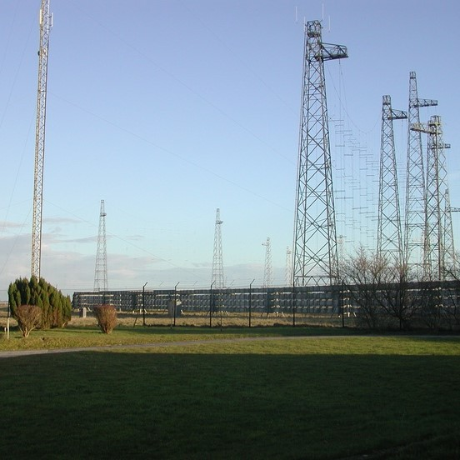
02
What is Docker?
"Why Not Just Use a VM?
What do you gain from Dockers?"

Slide 8

Dockers Make Life Easy!
Simply Put:
Virtual Machines, though they are fully independent, come with various caveats that dockers simply do not have!
This is because dockers do not need to run a full OS!
Building small, independent, and reliable dockers can give us the following benefits!

Slide 9



Docker Benefits
Isolation/Security
Internal Network
Portability
Dockers run as separate instances of our media sharing application.
Since we have properly configured them with AES & RSA, it makes them very difficult to attack!
Docker has its own internal network system, which is very useful for our project.
Allows for an almost "Peer-to-Peer" System to be implemented!
Dockers Have Fast Boot Times and are less resource intensive than VMs!
Our Dockers take up less than 500 MB of space!

Slide 10
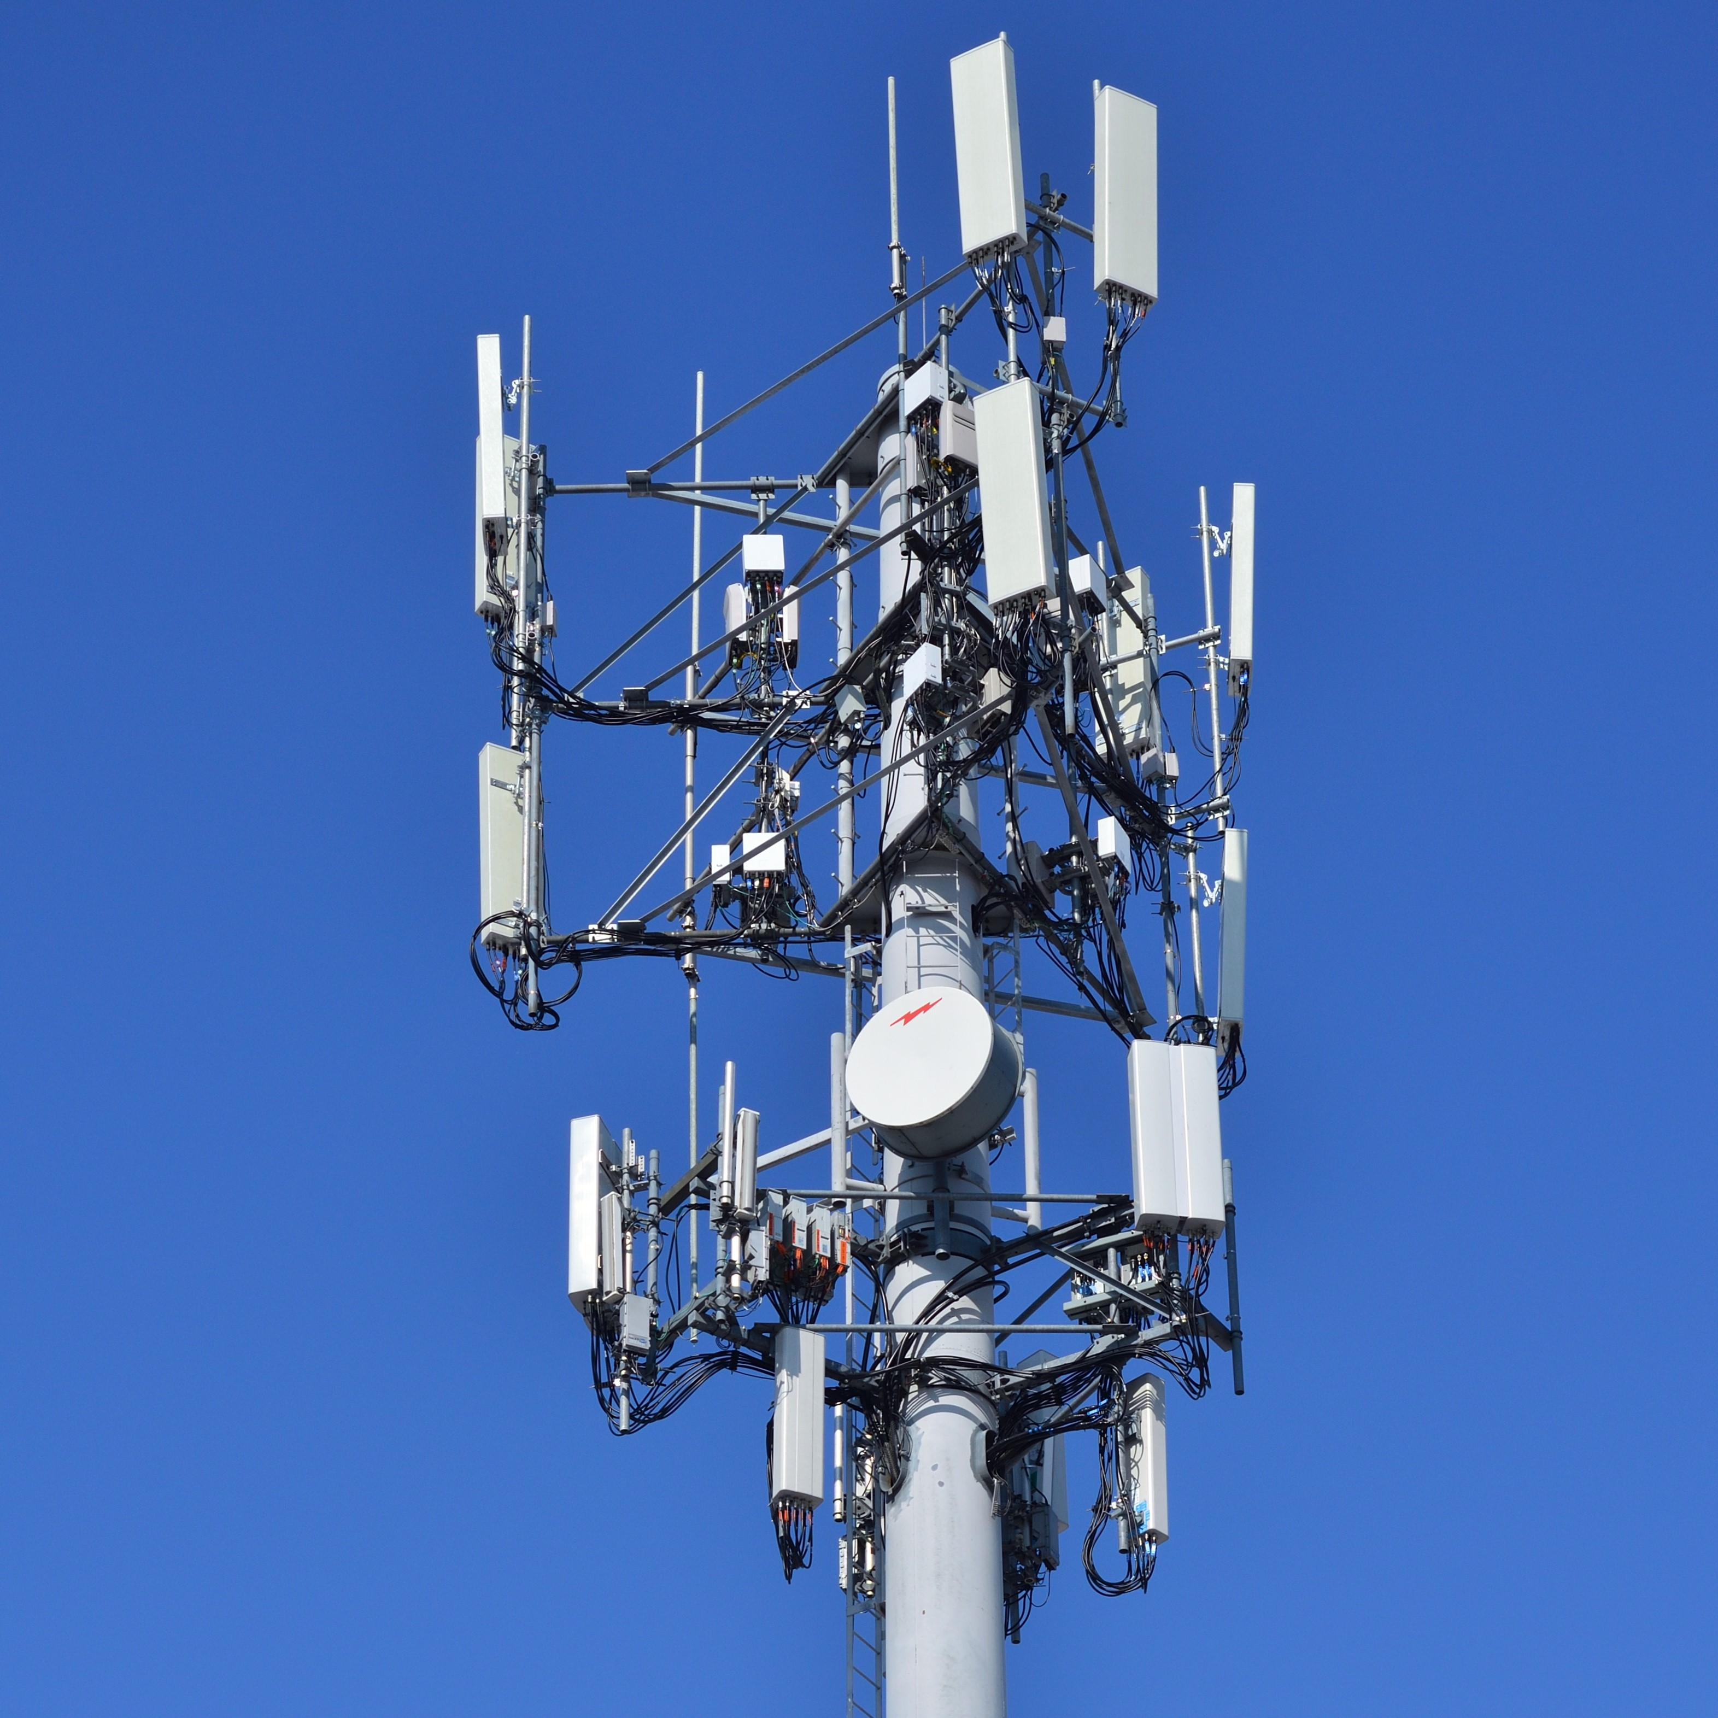
03
Setup / Project Timeline
"How long is it going to take?
How did you balance the project with your other schoolwork?"

Slide 11
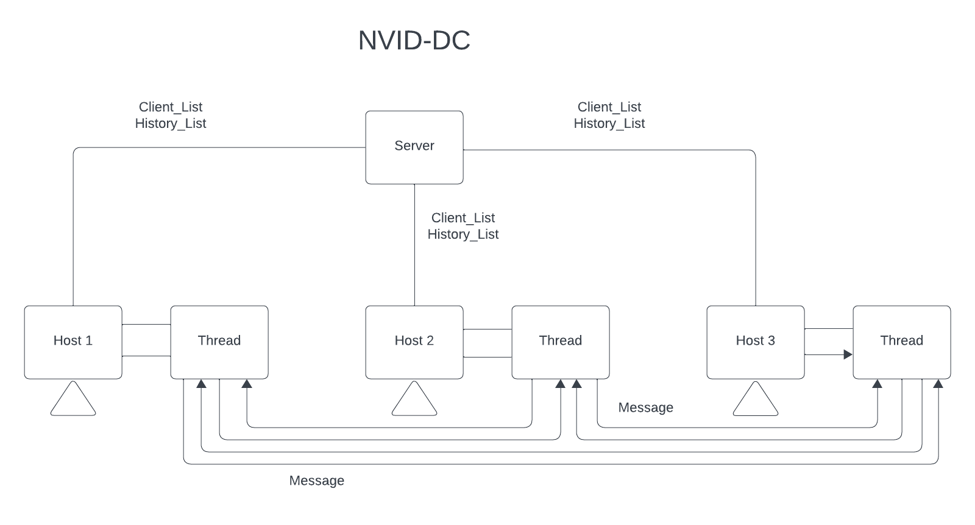
System Diagram
We started brainstorming, and ended up with this as our finalized architecture.
*So, How will we structure our messages?*

Slide 12
Message Structure
In order for us to be able to send images/videos in a correct manner, we used the following message structure.
Server-to-Client
Hello Message : Used to start communication [Includes HostName, IP, Public Key]
Update History : Updates The History [Client sends message about who its sending to, gets appended to history]
Send List : Sends the Client List from Server-to-Client [Update them on who is available]
Update Name : Sends a message containing the new name of the client to the server. [Used to update Client List]
Send Leave : Client tells Server they are no longer available. [Removed From Client List]
Client-to-Client
Peer-2-Peer Message : Is the actual content. [Contains Filename, Type, Enrypted File Contents, Encrypted Key]
*So, What Parts do we need to make this?*

Slide 13

What Parts do we Need?
Command Line
Type Compatibility
We need to ensure the idea works on the command line, before we can even continue!
Media comes in many types, so we want compatibility with a lot of formats!
Window Sizing
Encoding
/Displaying
We need a window size that is not too big or too small. NVID-DC should work everywhere!
We need the images to be wrapped and sent, then unwrapped and displayed properly!
Client-to-Client
Client-to-Server
We need Clients to connect directly to eachother for them to send media.
We need the Server to act as a middle ground for all the clients to use.
*So, how did we split up the work?*

Slide 14




Project Timeline
01
02
03
04
Encode and display basic image files, before expanding into other types. (.jpg, .png, etc.)
Date: 3/15/2024
Add the ability to send large volumes of packets, which we will need to send large pictures/videos.
Date: 3/1/2024
Refine the image encoding/display subsystems, add a few more file types, and get videos working.
Date: 3/29/2024
Develop the first prototype of our system, with the ability to throw basic text from one computer to another.
Due: 2/16/2024

Slide 15




Project Timeline
05
06
07
END
Refine System UI and bugfix.
Date: 4/26/2024
Create Final presentation and Documentation.
Date: 4/26/2024
Final
Submittables
Sent.
Date: 4/28/2024
Build the ability to queue images/videos, since for now it has only been 1-to-1.
Date: 4/12/2024
*So, how did it look after all of this?*

Slide 16
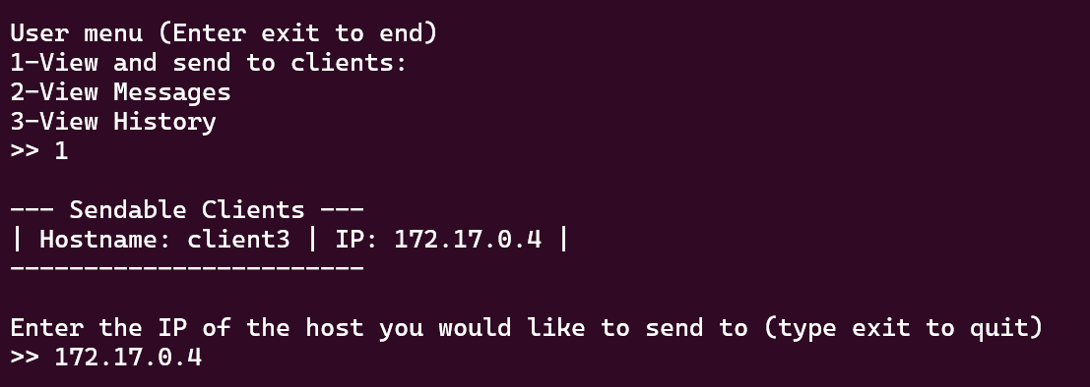
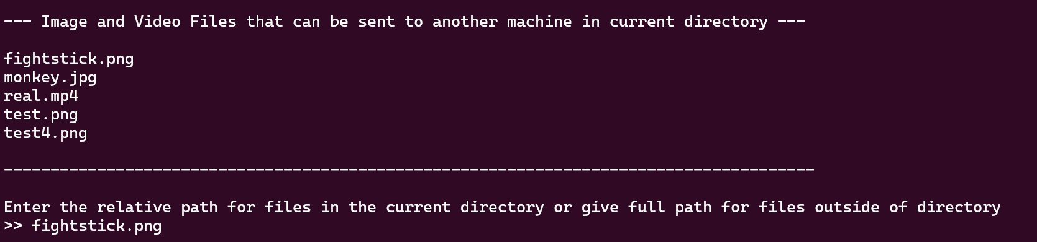
Command Line Version
Here’s the command line version of the system.
It has all functionalities we set out to accomplish.
But, we cannot really use this for a customer, right?
*Shouldn’t the client have some sort of GUI?*

Slide 17

04
UI Design / Development Difficulties
"How does it look to the user? What did we need to do?"

Slide 18





UI Considerations
Blue Coloration
Client List
Send History
Statistically, most Tech Companies use Blue in their designs.
“Not only is it the color most people cite as their favorite, but it’s also associated with stability and success.” (DeSantis Breindel, 2024).
We want the list of clients to be intuitive.
Users should be able to glance at it, much like a contact list on a phone.
Users should be able to see what images have already been sent with NVID-DC.
Once again, this was inspired by cell phones functionality, just like call history.
Auto Opening
Change Username
Smart Exiting
Any sent media should automatically open on the reciever.
Users should be able to rename themselves to be easier to find for others.
When a user stops using NVID-DC, they should be automatically removed from the Client List.

Slide 19
Problems We Encountered
Problem 1 [Fixed Via Docker Configuaration]
When moving towards using Dockers from VMs, we ran into a problem with local host testing.
NVID-DC is built to run on separate computers with unique IP addresses, which we had to learn to set up!
Problem 2 [Fixed Via Tkinter]
Setting up the GUI took a lot of research in order to get testing.
For a while, we were using Dash for our impementation, but it required too much resources, and often broke when the command line did not.
We moved to Tkinter to fix these problems.
Problem 3 [Fixed Via Message Formatting]
Early in development, we ran into files that would not open, due to having packets get corrupted.
We ended up using a smaller window and a new message format to stop files from corrupting, so they would display correctly.
Problem 4 [Fixed Via RSA & AES]
In early meetings with Dr. Tosh, it was brought to our attention that we needed some sort of security to prevent messages from being intercepted from their destination.
We implemented RSA and AES keys on the Client-to-Client sending.

Slide 20
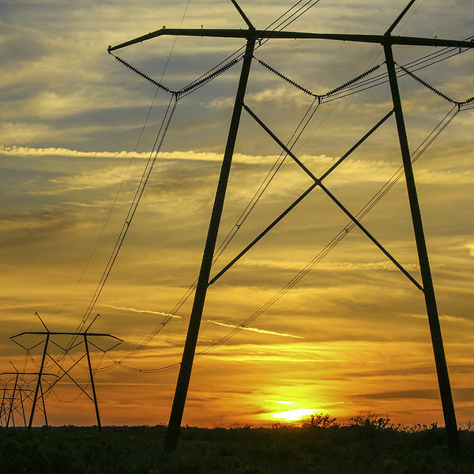
Results /
Project Screenshots
05
"Was NVID-DC Finished?
How does it look?"

Slide 21
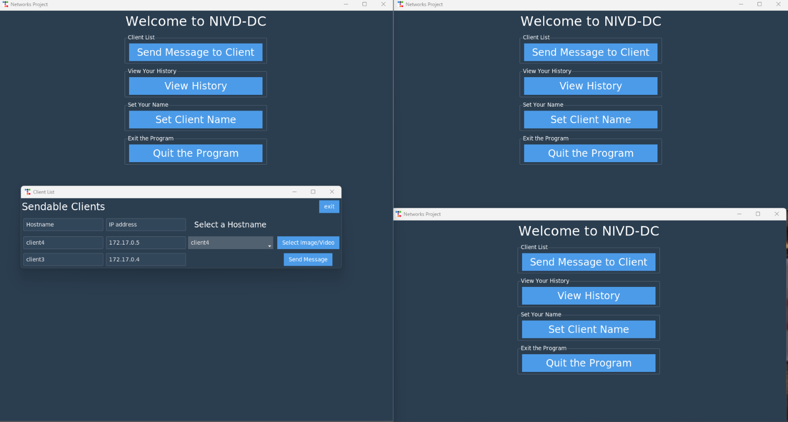
Main Menu Style/Options
Here’s our finalized look at the Client Side of NVID-DC.
Clicking any buttons opens sub-menus for Clients to interface with, seen to the side here with Client List: →
The User Also Has Access to all the functionality we designed for them, as seen below: ↓

Slide 22
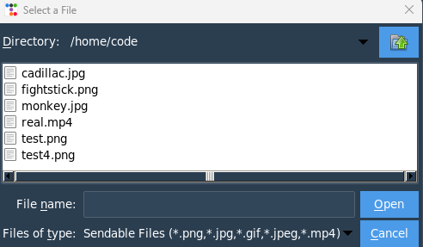
Selecting a File
From the Client List, you can select your reciepient and then a file.
This then opens a file browser for the Client to make their choice.
They can finally submit it!

Slide 23
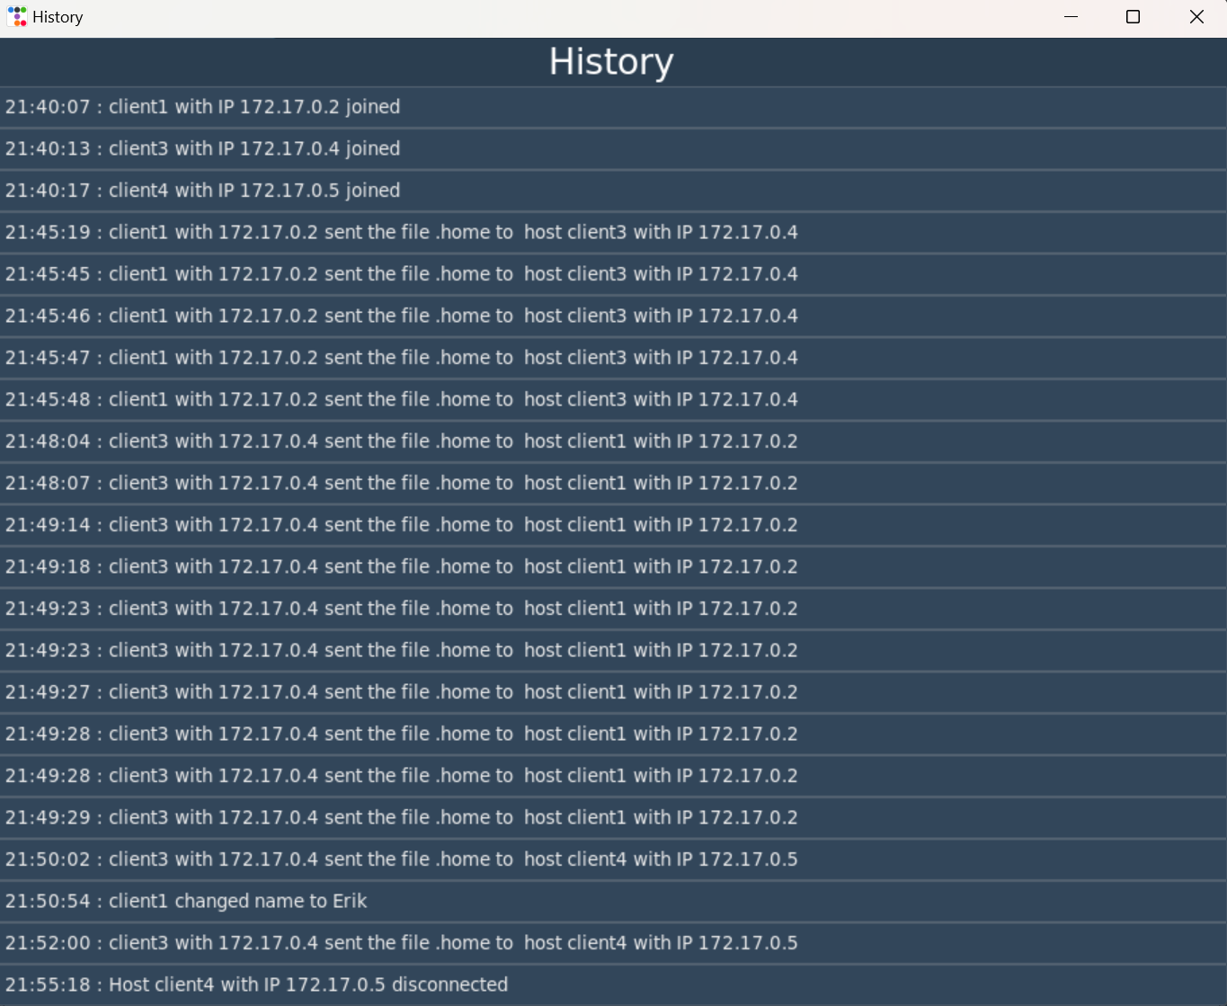
Viewing History!
NVID-DC does keep track of the history of what was sent, as seen below.
It also tracks who joined and who left.

Slide 24
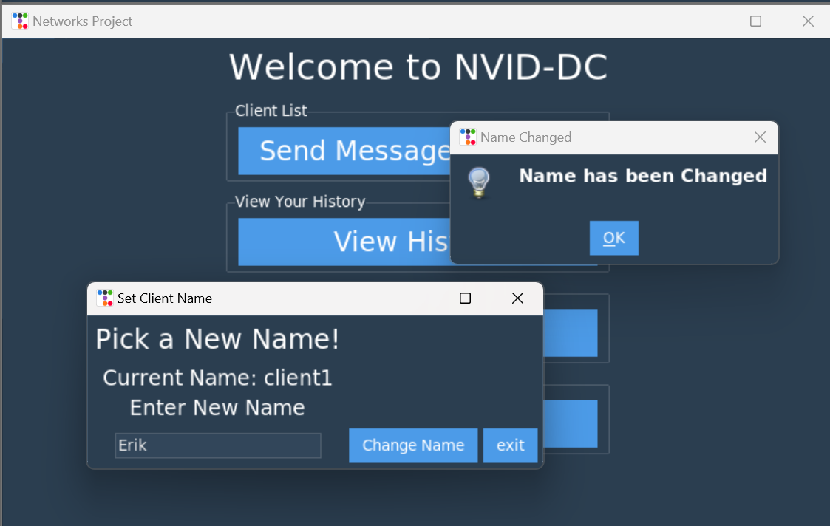
Changing Your Name!
NVID-DC allows for clients to change their name, so they are easier to find!
Users receive a confirmation pop-up when it is finished!

Slide 25
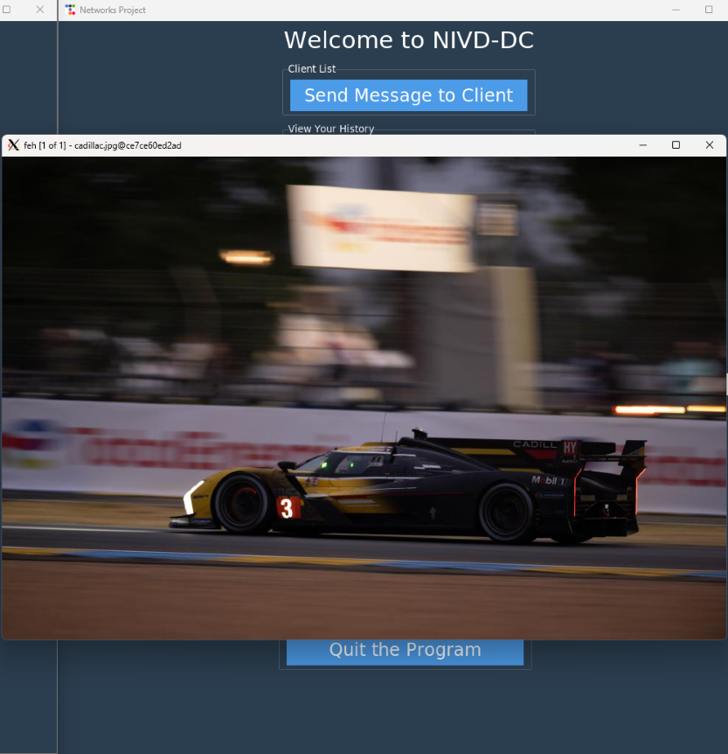
Message Received! [Photo]
When a photo is received, a popup will occur, showing the chosen media that was sent.
This can be used for humor or to surprise friends or family!
You can also auto-populate a screen for advertising!

Slide 26
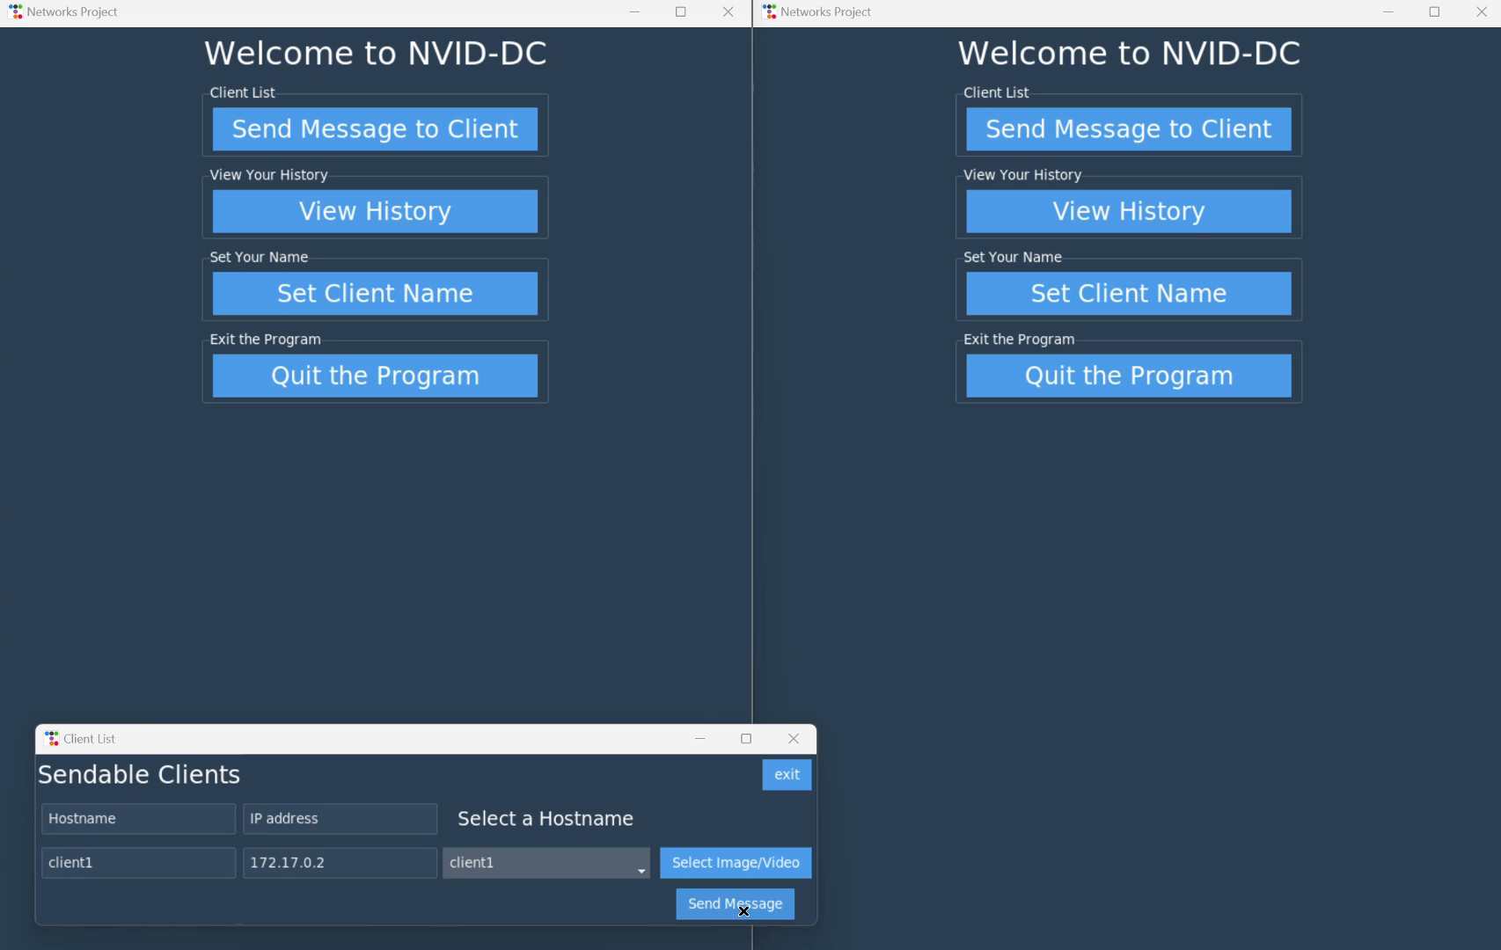
Message Received! [Video]
When a video is received, the popup will occur in much the same way as before!
Here’s an example we did with a .gif file.

Slide 27
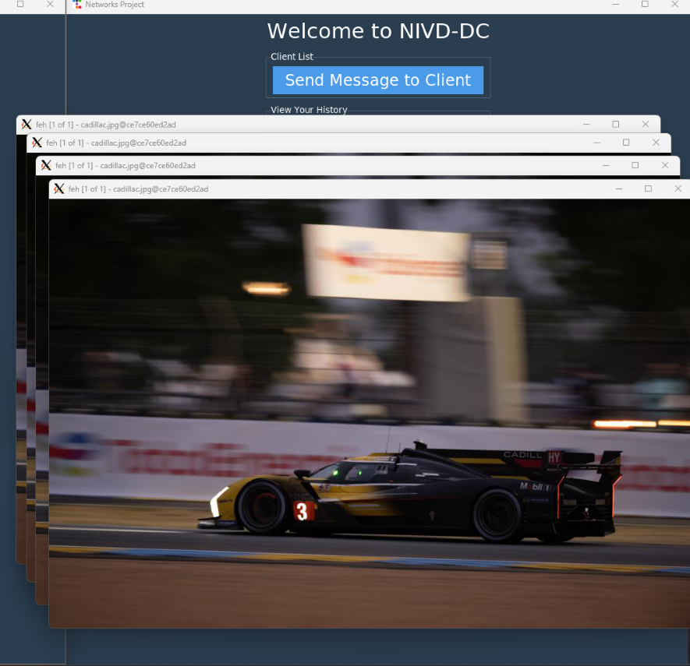
NVID-DC Performance
Due to the efficiency of NVID-DC, we can have multiple photos and videos displayed at the same time!
Extreme slowdown does not occur unless there is a substaintial amount of content being displayed all at once.

Slide 28

Conclusion
06
"What did we learn?
What can we do Differently?"

Slide 29
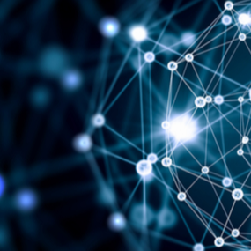
What Did We Learn?
This Project taught us many things, including the following:
How to better utilize dockers.
Make GUIs.
How to Set up our own messaging protocol.
How to translate work from a vertical slice to a finalized project.
How to encode Video/Pictures.
How to implement moderate security on messages.
How to better connect a front end to a backend.
How to communicate better as a team.

Slide 30
What Can We Do Differently/In The Future?
If we were to do this project again, we would do these things differently:
Start using Docker at the start instead of building a vertical slice with VMs.
Not use Dash for our GUI when none of us had proper experience with it.
In the Future, we would like to do the following:
Refine UI, possibly make a logo.
Add Options to UI. [Colorblind options, Text Formatting, User Customization].
More Verification between Server-to-Client.
Additional Security of Messages, in general.

Slide 31
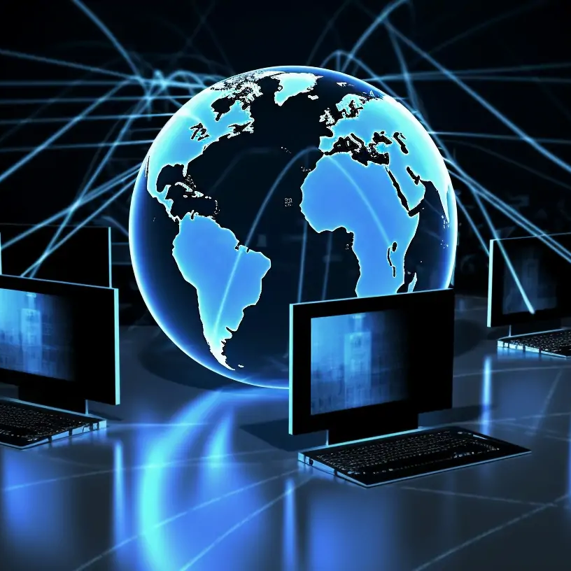

Thank You!
“Does Anyone Have Any Questions?
Please keep this slide for attribution

Slide 32
Picture Resources [Student Created]
Simple Logo Clipart
Microsoft. (n.d.). Logo Clipart. Built in Microsoft PowerPoint.
Student Portraits
Gonzalez, J. (2022). Professional Photo. [Photograph]. Provided by Student.
Guzman, G. (2022). Professional Photo. [Photograph]. Provided by Student.
LaNeave, E. (2022). Professional Photo. [Photograph]. Provided by Student.
Remes, F. (2022). Professional Photo. [Photograph]. Provided by Student.
Student Created Flowchart
NVID-DC Team. (2024). Flowchart of the Structure. Retrieved From https://lucid.app/lucidchart/d8816c23-512f-4e02- b189-2fd64d92603b/edit?viewport_loc=223%2C135%2C2219%2C1087%2C0_0&invitationId=inv_1cde067- 2028-4f93-8879-6d13bc48a4df
Student Created Output Screenshots
Guzman, G. (2024). Screenshot of Command Line User Menu [Screenshot]. Provided by Student.
LaNeave, E. (2024). Screenshot of Command Line Directory [Screenshot]. Provided by Student.
LaNeave, E. (2024). Screenshot of Final NVID-DC User Menu [Screenshot]. Provided by Student.
LaNeave, E. (2024). Screenshot of Final NVID-DC User Menu w/ Popup [Screenshot]. Provided by Student.
LaNeave, E. (2024). Screenshot of Final NVID-DC Select A File Menu [Screenshot]. Provided by Student.
LaNeave, E. (2024). Screenshot of Final NVID-DC Picture Received [Screenshot]. Provided by Student.
LaNeave, E. (2024). Video of Final NVID-DC Video Received [Video]. Provided by Student.
LaNeave, E. (2024). Screenshot of Final NVID-DC w/ Multiple Pictures Received [Screenshot]. Provided by Student.

Slide 33
Picture Resources [Slides Part 1]
Additional Photos [In-order of Appearance]
Freepik. (2024). Against canvas: Starry night sky with electricity transmission towers crowned with wires stand tall, capturing the enchanting essence of energy infrastructure [Photograph]. Retrieved from https://www.freepik.com/premium-ai-image/against-canvas-starry-night-sky-electricity- transmission-towers-crowned-with-wires-stand-tall-capturing-enchanting-essence-energy- infrastructure_140931096.htm
Adobe Stock. (2024). Electronic circuit board close-up on blue background [Photograph]. Retrieved from https://stock.adobe.com/images/electronic-circuit-board-close-up-blue- background/376478081
Williams, S. (2002). Free as in Freedom: Richard Stallman’s Crusade for Free Software [Photograph]. Retrieved from https://books.google.com/books/about/Free_as_in_Freedom_ Paperback.html?id=BB68Ql7ZY_AC
Pinterest. (n.d.). HF Curtain Array, Rampisham Transmitting Station, Dorset, UK [Photograph]. Retrieved from https://www.pinterest.com/pin/hf-curtain-array-rampisham-transmitting-station-dorset- uk--507921664194365862/
Docker. (2013). Logo of Docker, a Linux container engine [Photograph]. Retrieved from https://en.wikipedia.org/wiki/File:Docker_%28container_engine%29_logo_%28cropped%29.png

Slide 34
Picture Resources [Slides Part 2]
Additional Photos [In-order of Appearance]
Wikimedia Commons. (n.d.). Cell Tower, Richmond Hill [Photograph]. Retrieved from https://upload.wikimedia.org/wikipedia/commons/1/18/CellTowerRichmondHill.jpg
LinkedIn. (2022). How to Choose a Server Rack: What Factors Should You Consider? [Photograph]. Retrieved from https://media.licdn.com/dms/image/C5612AQHPO9kCUeFDgA/article-cover_image- shrink_720_1280/0/1651560827418?e=2147483647&v=beta&t=8aqHSnOZDWQws4F- 0nnGXjha96HYbescmlb29Wx1jas
Shutterstock. (n.d.). Close-up of a professional female doctor wearing a stethoscope [Photograph]. Retrieved from https://www.shutterstock.com/image-photo/close-professional-female-doctor-wearing-600nw- 1926175175.jpg
Humeston, D. (2016). Sunset Power Lines [Photograph]. Fine Art America. Retrieved from https://images.fineartamerica.com/images/artworkimages/mediumlarge/1/sunset-power-lines-dart- humeston.jpg
Shutterstock. (2014). Conclusion Text on Red Keyboard [Photograph]. Retrieved from https://www.shutterstock.com/image-photo/conclusion-text-on-red-keyboard-260nw-343747988.jpg
Shutterstock (2022). Abstract background with glowing particles and light trails [Photograph] Retrieved from https://images.spiceworks.com/wp-content/uploads/2022/01/17143756/shutterstock_357107174.jpg
Mediamanager. (2023). O que é rede de computadores [Photograph]. Retrieved from https://mediamanager.com.br/wp-content/uploads/2023/04/O-que-e-rede-de-computadores.png

Slide 35
Text Resources
Textbooks
Du, W. (2022). Internet Security: A Hands-on Approach (3rd ed.). Independently Published. ISBN: 1733003967.
Kurose, J. F., & Ross, K. W. (2024). Computer Networks: A Top-Down Approach (8th ed.). Pearson Education. ISBN: 9356061319.
Peterson, L. L., & Davie, B. S. (2019). Computer Networks: A Systems Approach (6th ed.). Pearson Education. ISBN: 0128182008.
Websites
Amos, D. (2019). Python GUI Programming with Tkinter. Retrieved from https://realpython.com/python-gui-tkinter/
DeSantis B. (2024). B2B Tech Brand Colors: What Factors Should You Consider? [Article]. Retrieved from https://www.desantisbreindel.com/insights/b2b-tech-brand- colors/#:~:text=For%20tech%20companies%2C%20blue%20is%20always%20true&text=Blue%2 0is%20a%20perennial%20choice,be%20an%20extremely%20competent%20one.
Python Software Foundation. (n.d.). tkinter — Python interface to Tcl/Tk — Python 3.12.3 documentation. Retrieved from https://docs.python.org/3/library/tkinter.html
Stallman, R. (2012). Sharing is good, and with digital technology, sharing is easy. QuoteFancy. Retrieved from https://quotefancy.com/quote/1425553/Richard-Stallman-Sharing-is-good-and-with-digital-technology- sharing-is-easy

